Slide 1
cloud service providers

Slide 2
cloud service providers
AWS. Amazon Web Services or AWS is the cloud platform from technology and e-commerce giant Amazon.
Azure is an IaaS provider from Microsoft
Google Cloud. Google Cloud Platform or GCP from the Google stable is a market-leading cloud computing service.
Digital Ocean
IBM, Cisco Systems, VMware, Sify

Slide 3
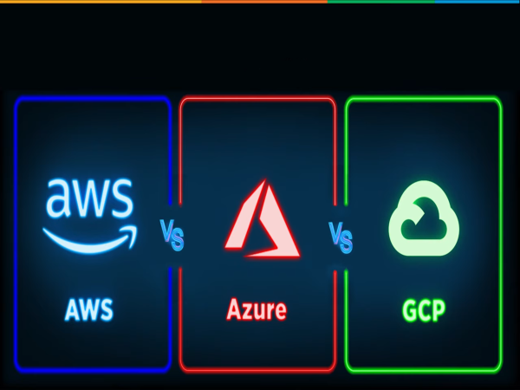
aws and azure AND GCP comparison

Slide 4
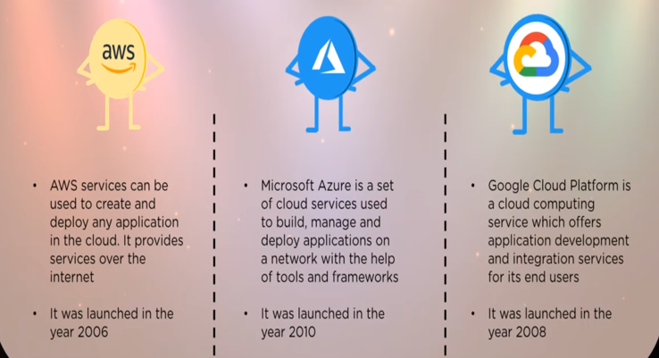

Slide 5
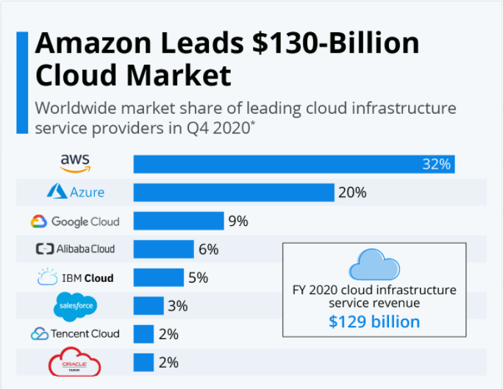

Slide 6
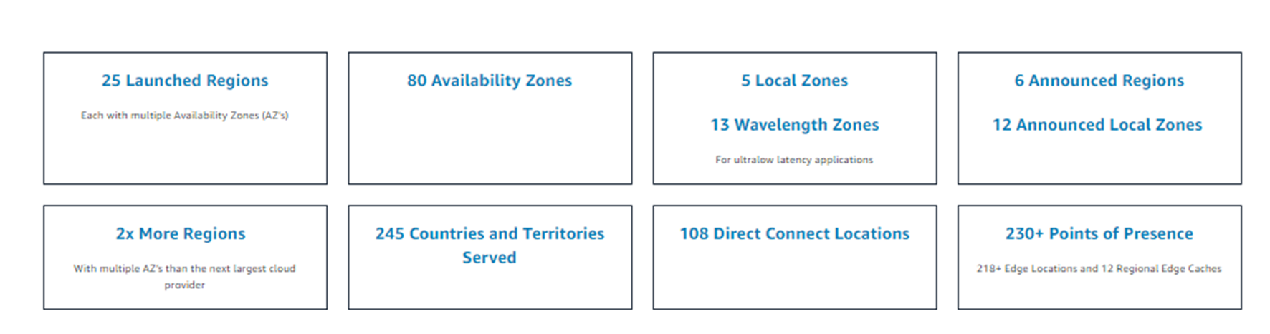
(Aws) Availability zone and region

Slide 7
(Azure) Availability zone and region
52 Regions.
Announced for 6 additional regions.
16 AZ's
Announced for 18 Azs

Slide 8
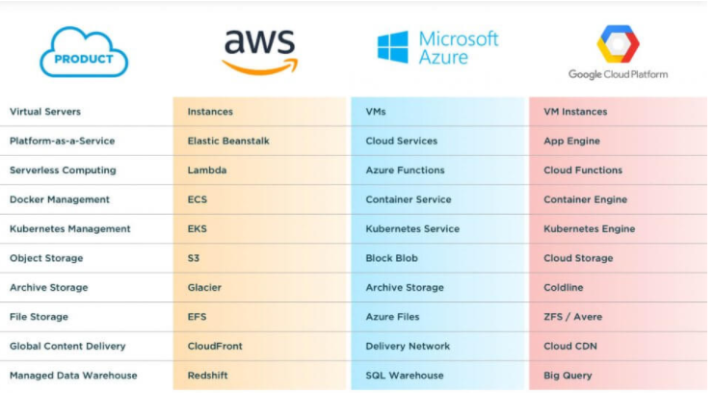

Slide 9
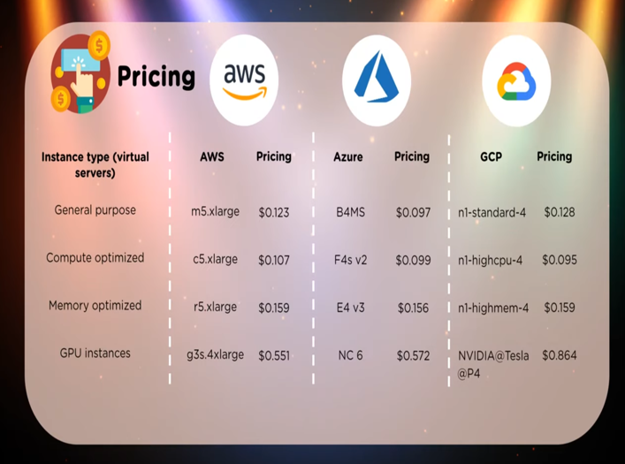

Slide 10
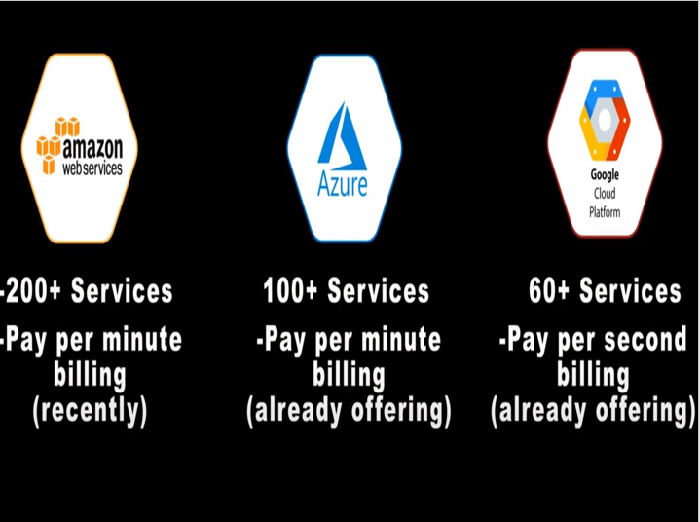

Slide 11
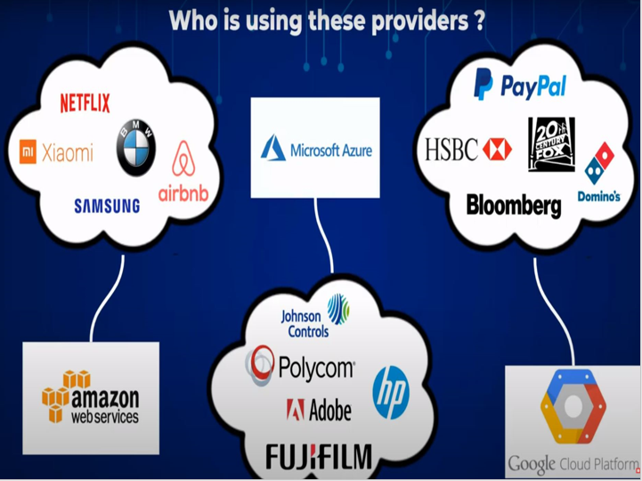

Slide 12
